Slide 1

Escuela Politécnica nacional
David Fabián Cevallos Salas
August, 2023

Slide 2
Privacy Malware Classifiers based on Memory Dumping Analysis
David Fabián Cevallos Salas
Escuela Politécnica Nacional
2

Slide 3
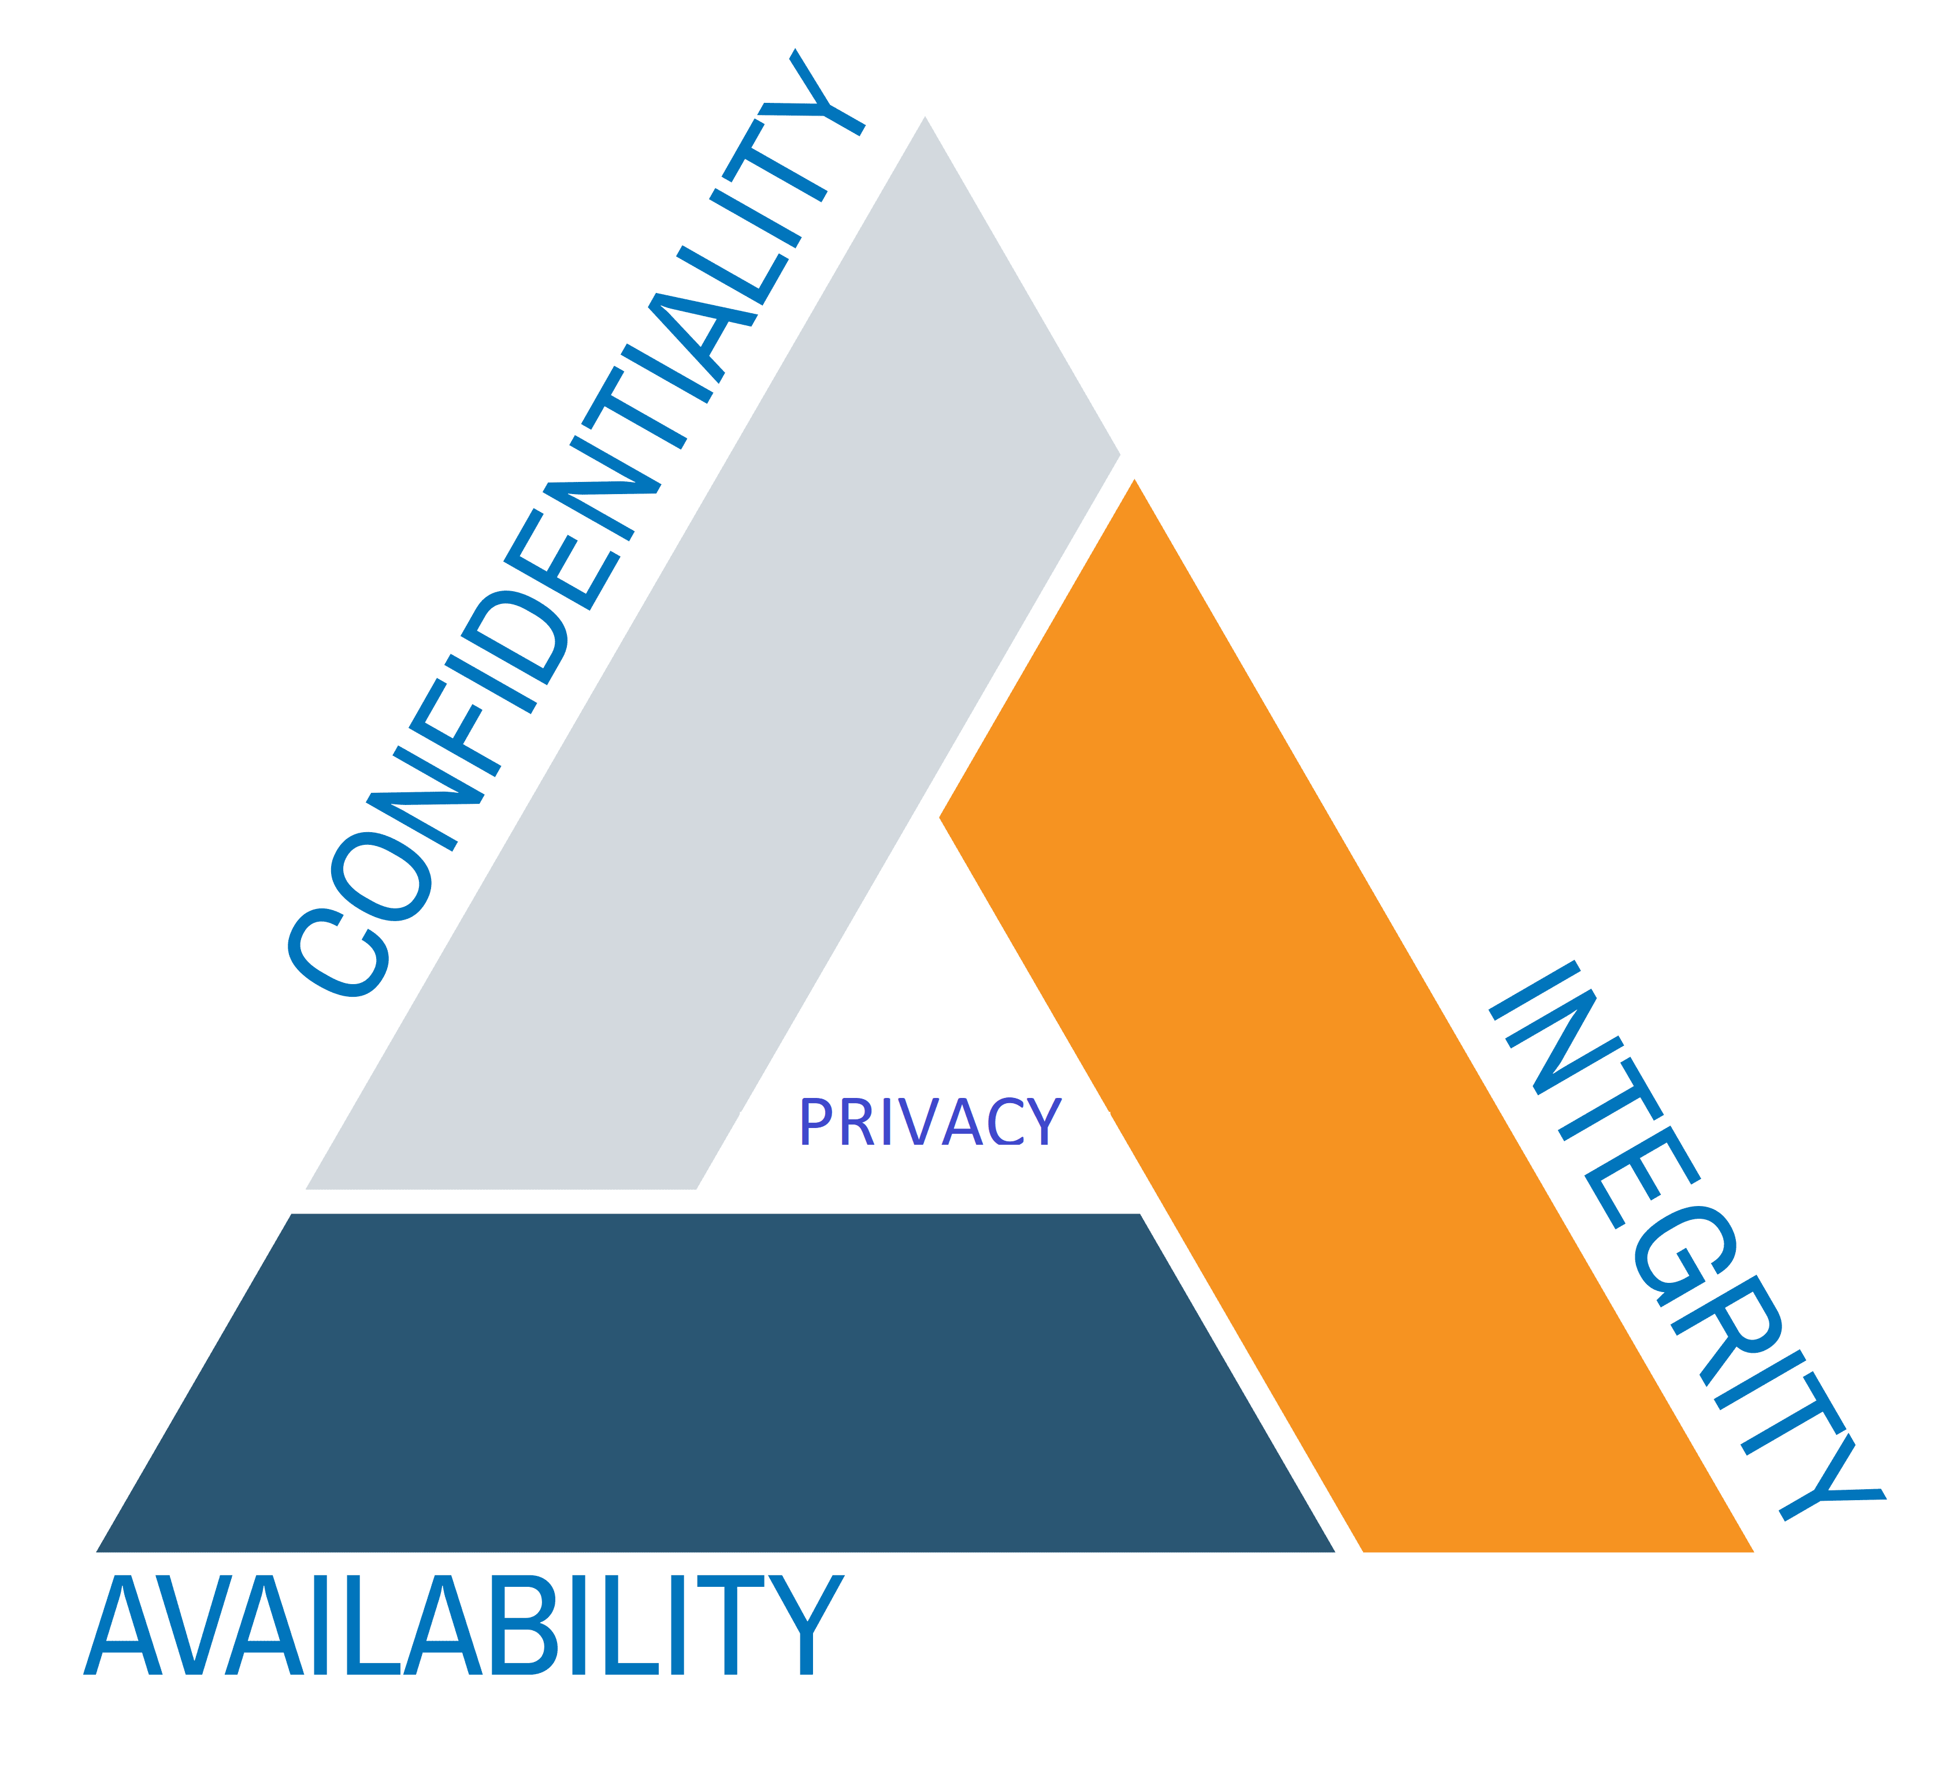

Introduction
Privacy regulations
(GDPR, LOPDP, others…)
Digital commerce and online services
E-learning, E-health, others…
E-government
3

Slide 4
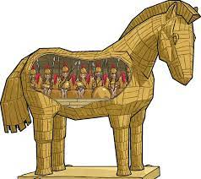


Privacy Malware
Spyware
Ransomware
Trojan Horse
Resemble being a valid application.
Collect data throught snooping and eavesdropping.
Command and control sequences.
Cypher information.
4

Slide 5
Problem
Before runtime
Runtime
Existing controls mitigate risks
Users education plays a major role
More effort has been made in this stage
Difficult detection
Attack stopping is usually made by human intervention
Generally produce a data leakage
5

Slide 6

Related Work
AML with LSTM [1]
Chip multiprocessors [2]
Self learning DNN [3]
Heterogeneous Deep Neuronal Network [4]
Bidirectional Long Short-Term
Memory NN [5]
Parallel Computing [6]
Refereces
[1] I. Yilmaz, A. Siraj, and D. Ulybyshev, “Improving DGA-Based malicious domain classifiers for malware defense with adversarial machine learning,” 4th IEEE Conference on Information and Communication Technology, CICT 2020, 2020
[2] B. Kumar, S. Thakur, K. Basu, M. Fujita, and V. Singh, “A low overhead methodology for validating memory consistency models in chip multiprocessors,” Proceedings - 33rd International Conference on VLSI Design, VLSID 2020 - Held concurrently with 19th International Conference on Embedded Systems, pp. 101–106, 2020
[3] J. Yang and Y. Guo, “AEFETA: Encrypted traffic classification framework based on self-learning of feature,” 2021 IEEE 6th International Conference on Intelligent Computing and Signal Processing, ICSP 2021, no. Icsp, pp. 876–880, 2021.
[4] L. Yang, G. Liu, Y. Dai, J. Wang, and J. Zhai, “Detecting stealthy domain generation algorithms using heterogeneous deep neural network framework,” IEEE Access, vol. 8, pp. 82 876–82 889, 2020.
[5] Girinoto, H. Setiawan, P. A. W. Putro, and Y. R. Pramadi, “Comparison of LSTM Architecture for Malware Classification,” Proceedings - 2nd International Conference on Informatics, Multimedia, Cyber, and Information System, ICIMCIS 2020, pp. 93–97, 2020.
[6] D. Appello, P. Bernardi, A. Calabrese, S. Littardi, G. Pollaccia, S. Quer, V. Tancorre, and R. Ugioli, “Accelerated Analysis of Simulation Dumps through Parallelization on Multicore Architectures,” Proceedings - 2021 24th International Symposium on Design and Diagnostics of Electronic Circuits and Systems, DDECS 2021, pp. 69–74, 2021
6

Slide 7

Methodology: Dataset
CIC-MalMem-2022
Created by the Canadian Institute for Cybersecurity of the University of New Brunswick (CICUNB).
29.298 benign processes and 29.298 malicious processes
55 features including (Number of threads, number of handles, callbacks, mutex, semaphores, etc)
Malware Category | Malware Family | Count
Spyware | 180Solutions | 2.000
 | Coolwebsearch | 2.000
 | Gator | 2.200
 | Transponder | 2.410
 | TIBS | 1.410
Ransomware | Conti | 1.988
 | Maze | 1.958
 | Pysa | 1.717
 | Ako | 2.000
 | Shade | 2.128
Trojan Horse | Zeus | 1.950
 | Emotet | 1.967
 | Refroso | 2.000
 | Scar | 2.000
 | Reconyc | 1.570
7

Slide 8
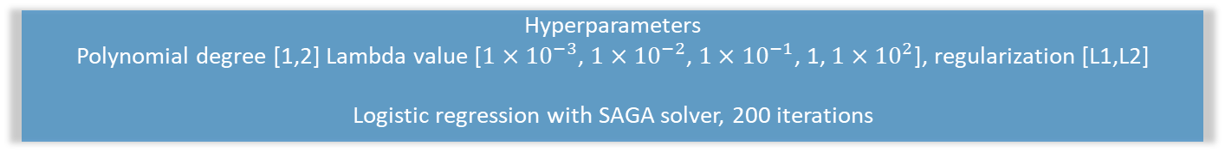
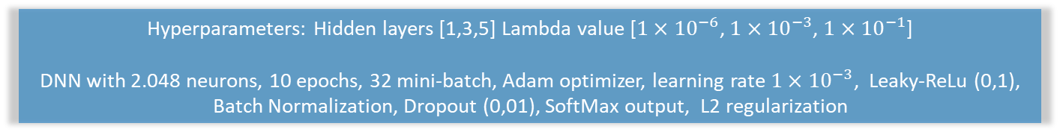
Methodology: Methods
CIC-MalMem-2022
1. Data acquisition
2. Data cleaning and preprocessing
3. Data visualization
4. Binary classifier
Validation Metric:
- Recall
Testing Metrics:
- Recall
- Accuracy
- AUC
Hyperparameters
Polynomial degree [1,2] Lambda value [$1×{10}^{−3}$, $1×{10}^{−2}$, $1×{10}^{−1}$, 1, $1×{10}^{2}$], regularization [L1,L2]
Logistic regression with SAGA solver, 200 iterations
5. Multiclasses classifiers
Validation Metric:
- Average micro-recall
Testing Metrics:
- W Precision
- W Recall
- W F1-score
- AUC
Hyperparameters: Hidden layers [1,3,5] Lambda value [$1×{10}^{−6}$, $1×{10}^{−3}$, $1×{10}^{−1}$]
DNN with 2.048 neurons, 10 epochs, 32 mini-batch, Adam optimizer, learning rate $1×{10}^{−3}$, Leaky-ReLu (0,1), Batch Normalization, Dropout (0,01), SoftMax output, L2 regularization
6. Digital Image Processing
7. Reporting
8

Slide 9
Methodology: Methods
Digital Image Processing
9

Slide 10







Methodology: Methods
Tools
10

Slide 11
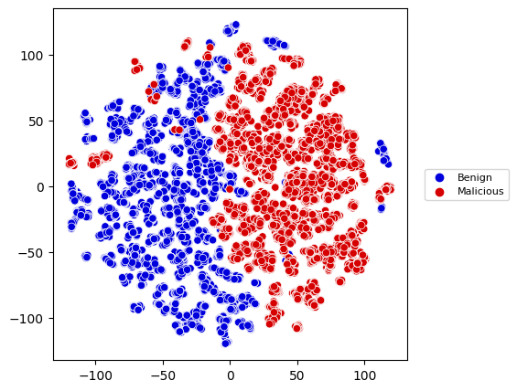
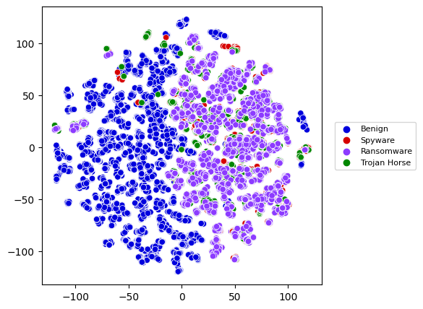
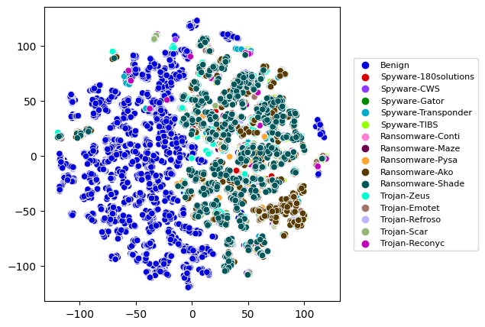
Analysis and Results: t-SNE Visualization
16-classes case
Perplexity 100
Binary case
4-classes case
Perplexity 100
Perplexity 100
11

Slide 12
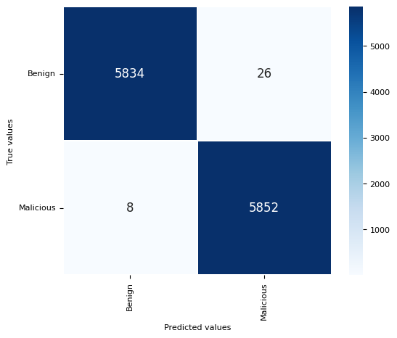
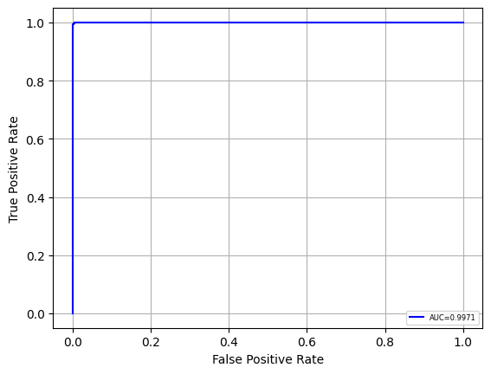
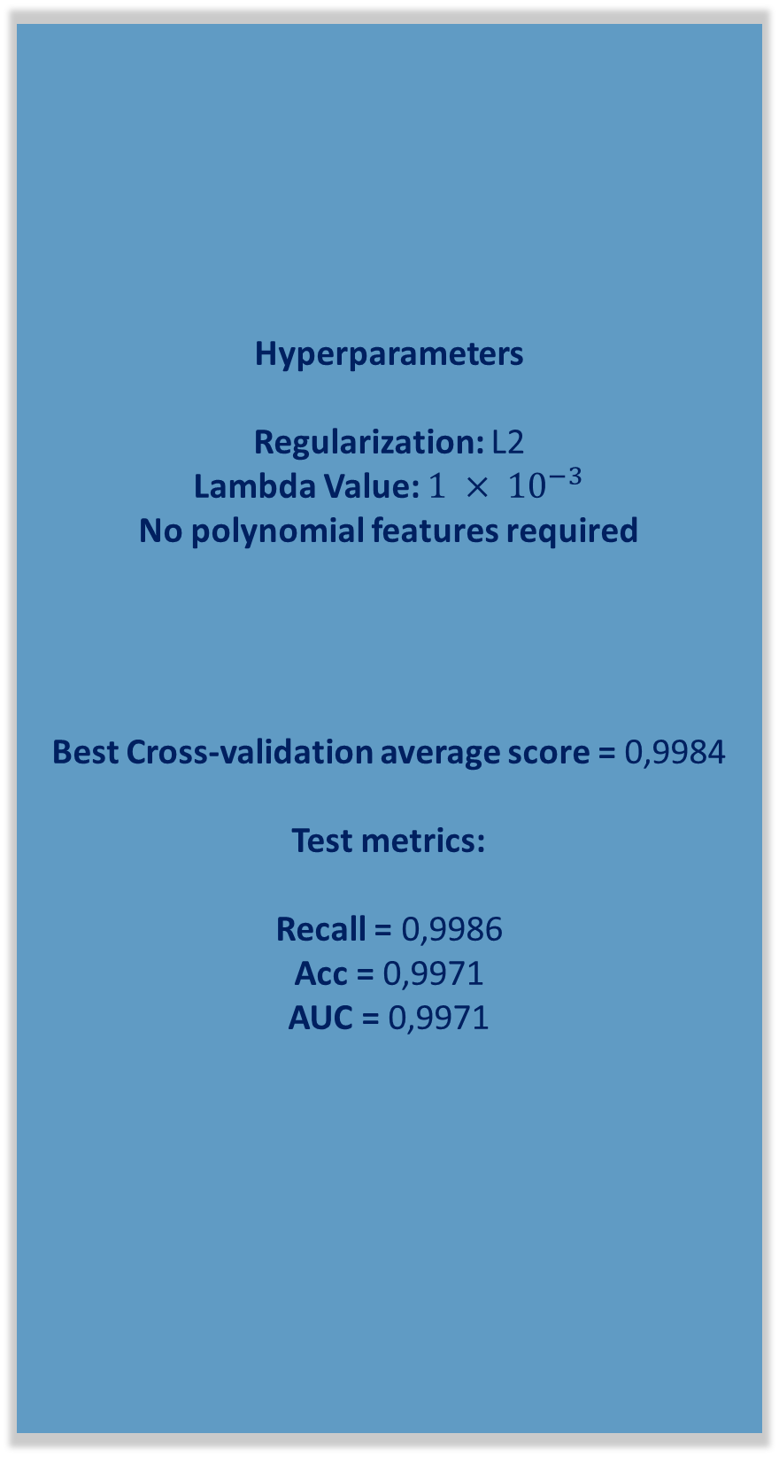
Analysis and Results: Binary classifier
Hyperparameters
Regularization: L2
Lambda Value: $1 × {10}^{−3}$
No polynomial features required
Best Cross-validation average score = 0,9984
Test metrics:
Recall = 0,9986
Acc = 0,9971
AUC = 0,9971
12

Slide 13
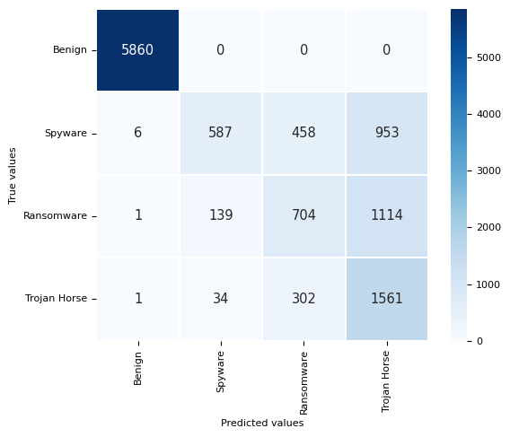
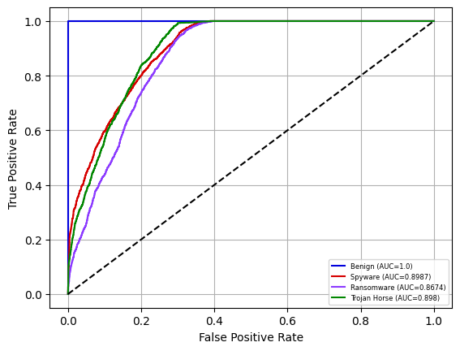
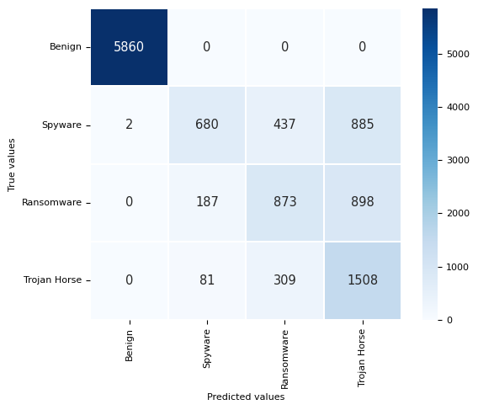
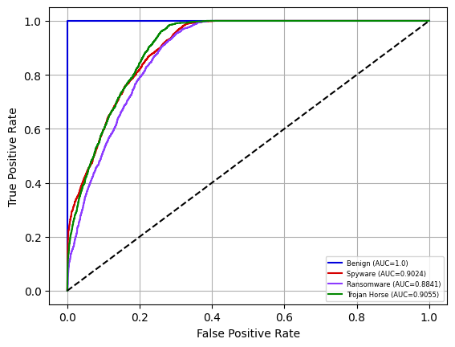
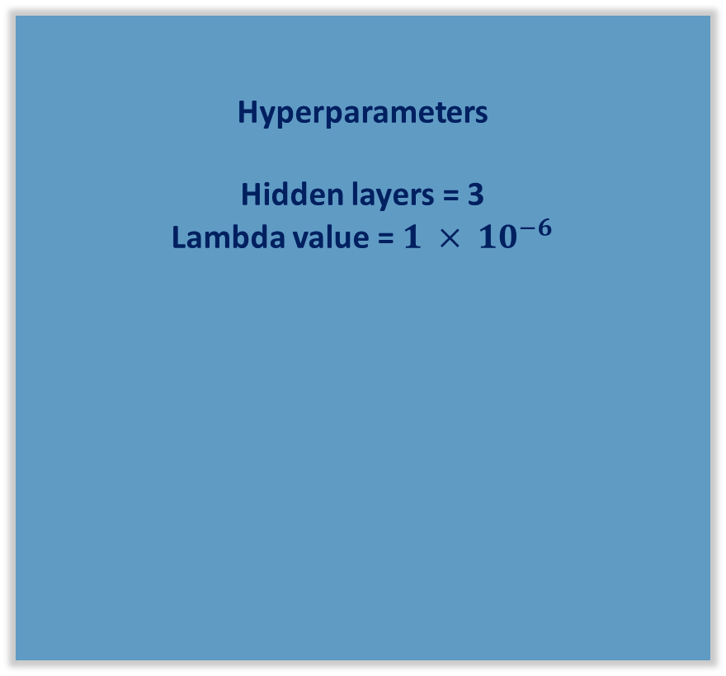
Analysis and Results: 4-classes classifier
Hyperparameters
Hidden layers = 3
Lambda value = $1 × {10}^{−6}$
NO SMOTE
Best Cross-validation average score = 0,7538
SMOTE Best Cross-validation average score = 0,7686
Test Metrics
Precision = 0,7814
Recall = 0,7433
F1-score = 0,7325
AUC = 0,9160
Test Metrics (SMOTE)
Precision = 0,7868
Recall = 0,7611
F1-score = 0,7544
AUC = 0,9230
SMOTE
13

Slide 14
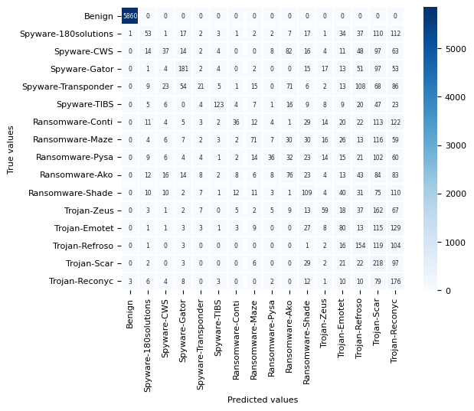
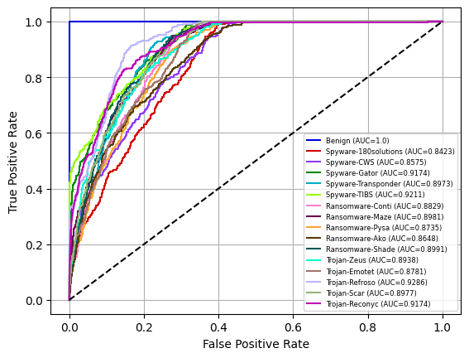
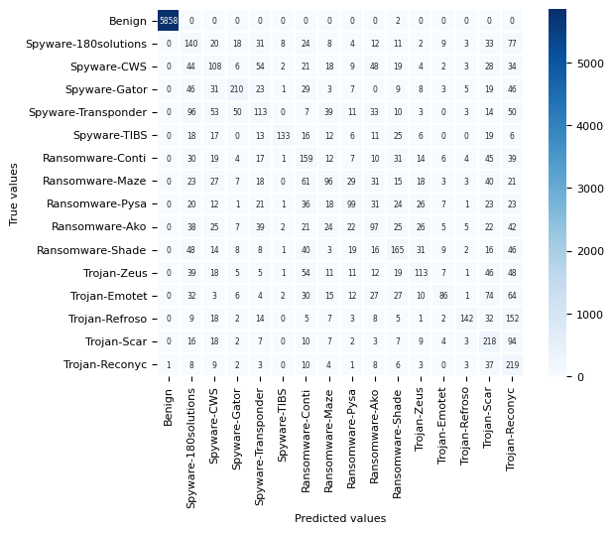
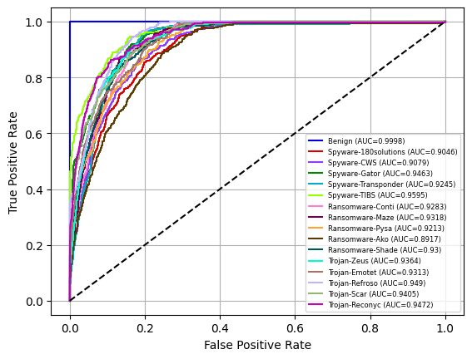
Analysis and Results: 16-classes classifier
Hyperparameters
Hidden layers = 3
Lambda value = $1 × {10}^{−6}$
NO SMOTE
Best Cross-validation average score = 0,6202
SMOTE Best Cross-validation average score = 0,6830
Test Metrics
Precision = 0,6788
Recall = 0,6220
F1-score = 0,6208
AUC = 0,8981
Test Metrics (SMOTE)
Precision = 0,7115
Recall = 0,6789
F1-score = 0,6815
AUC = 0,9344
SMOTE
14

Slide 15
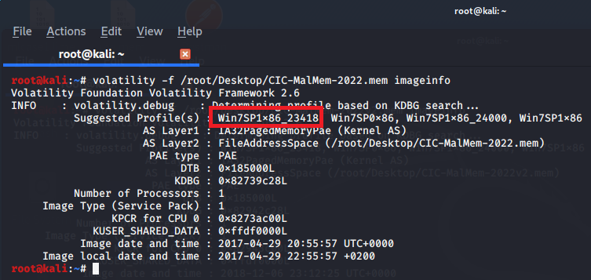
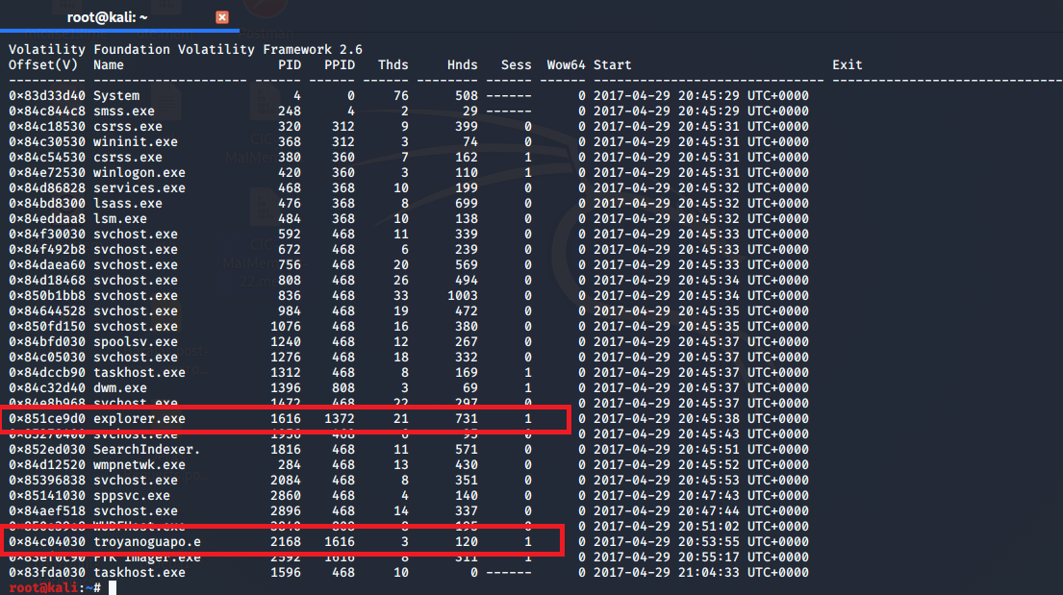
Analysis and Results: Memory Dumping
15

Slide 16
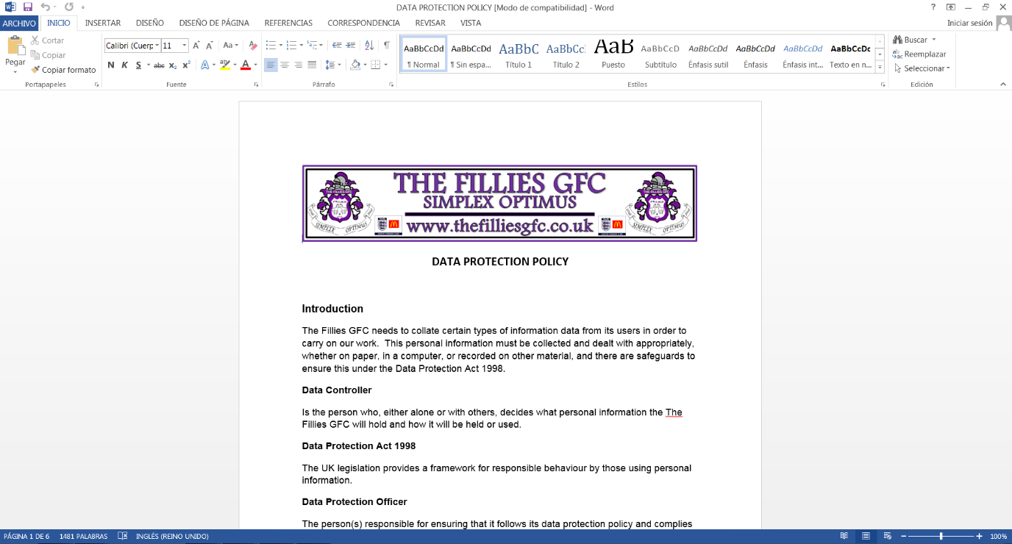
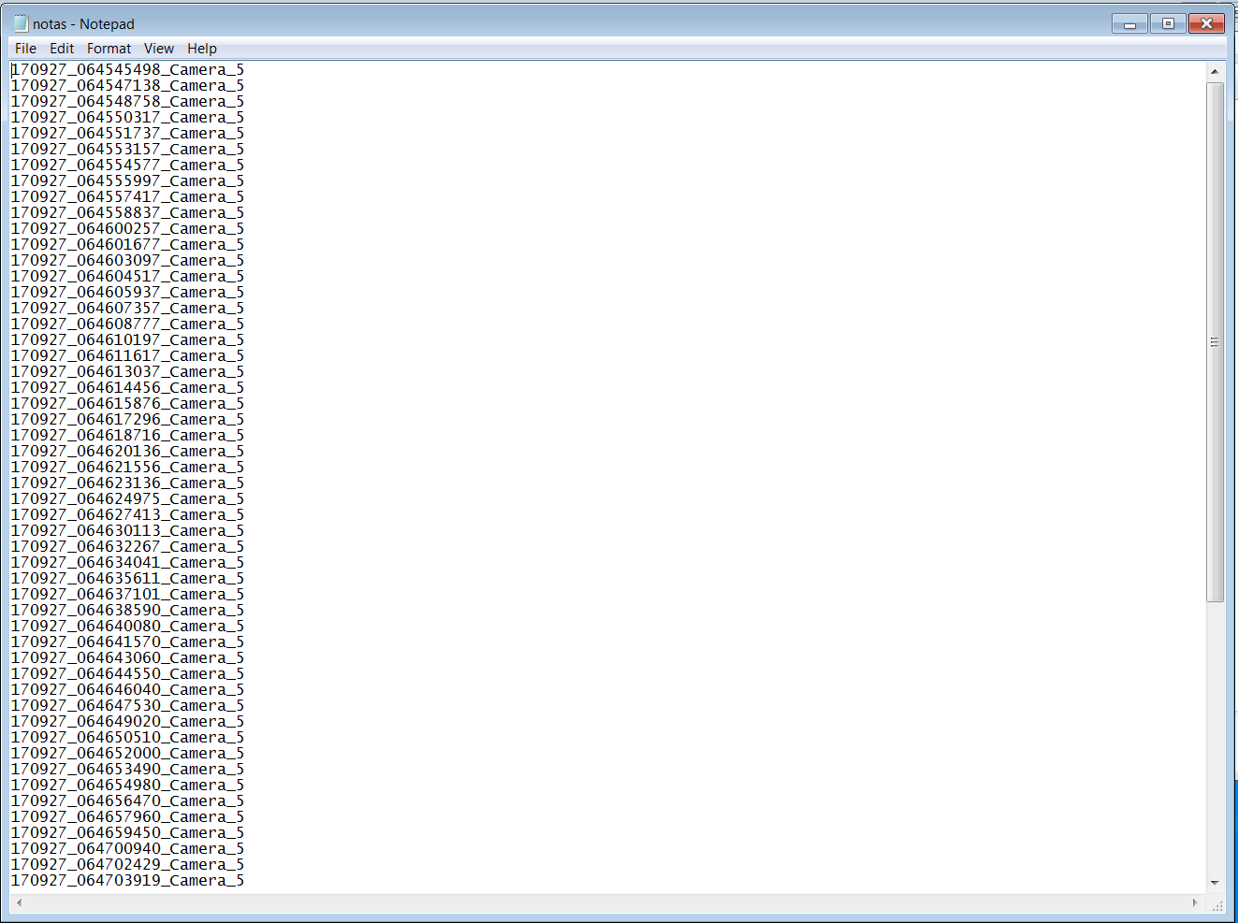
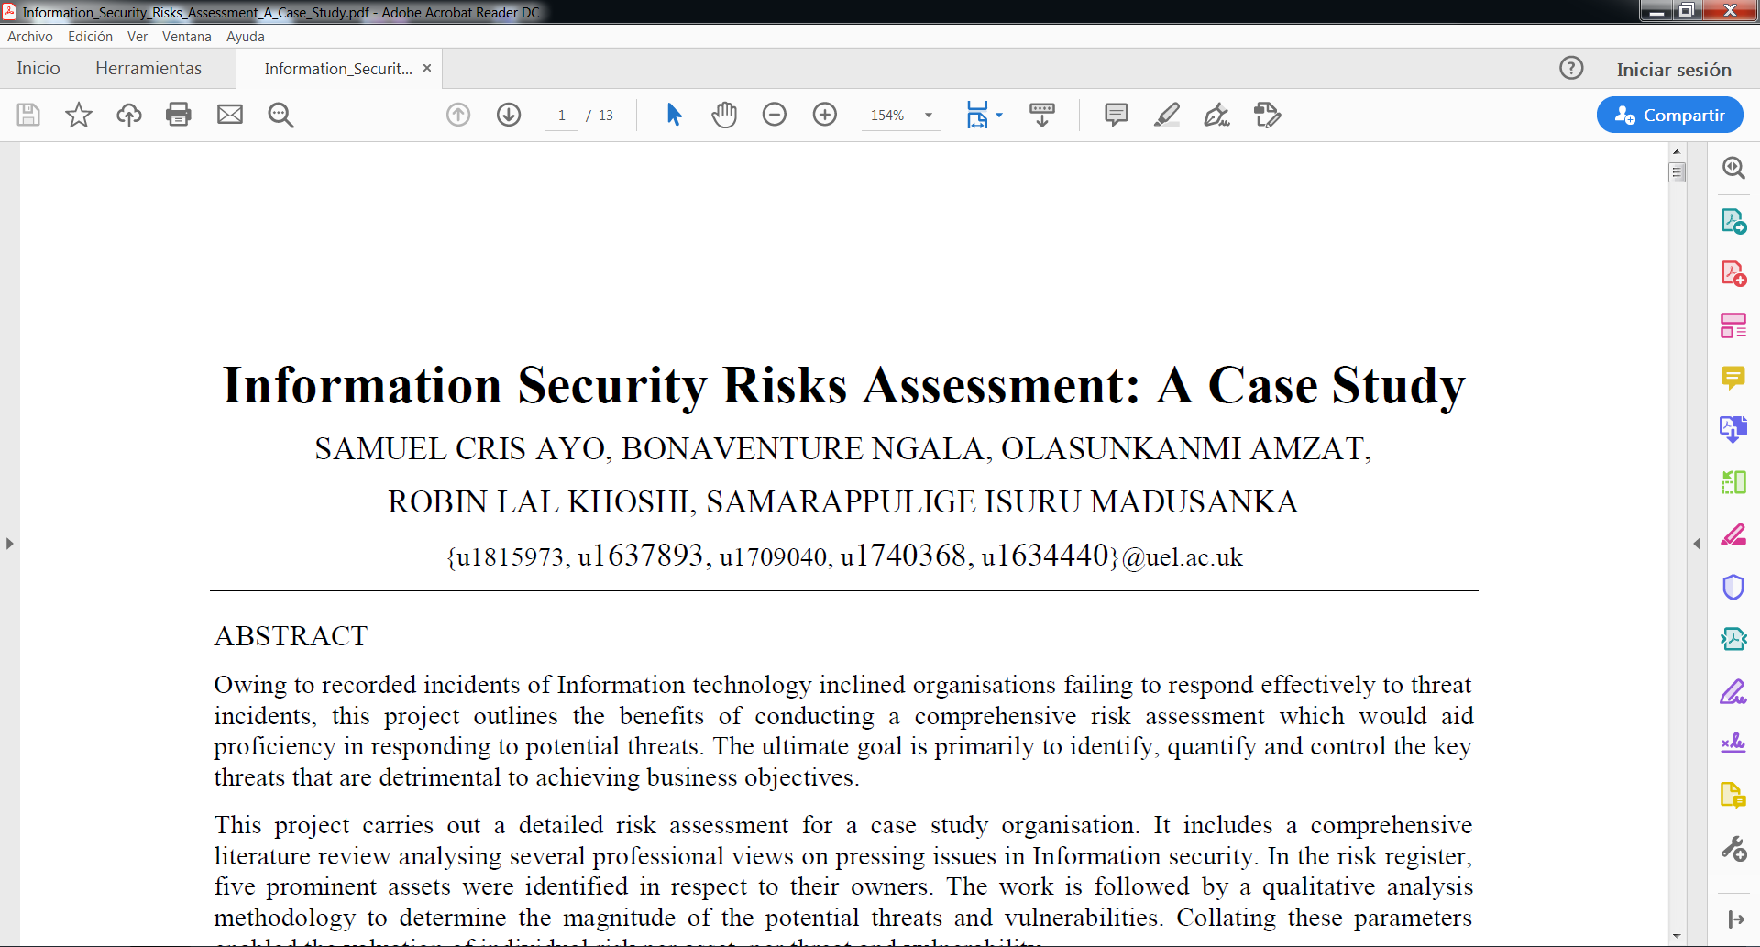
Analysis and Results: Memory Dumping
Recovered
Recovered
Recovered
16

Slide 17
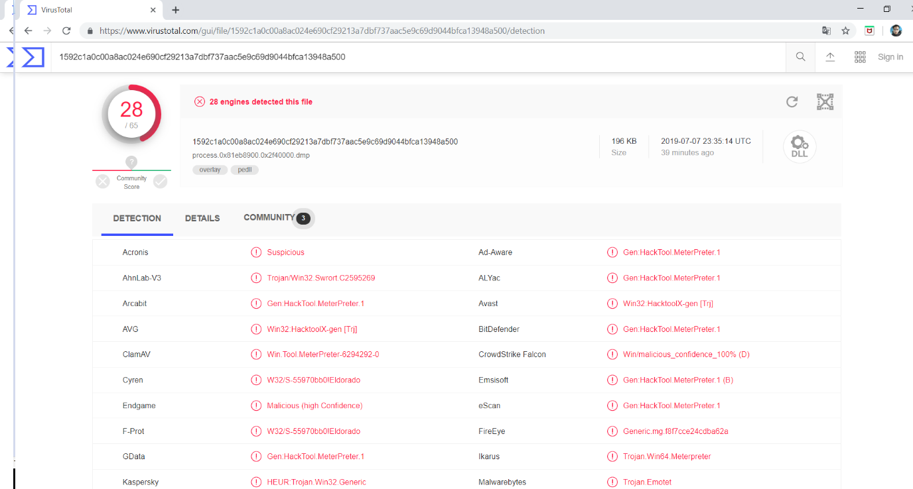
Analysis and Results: Memory Dumping
17

Slide 18
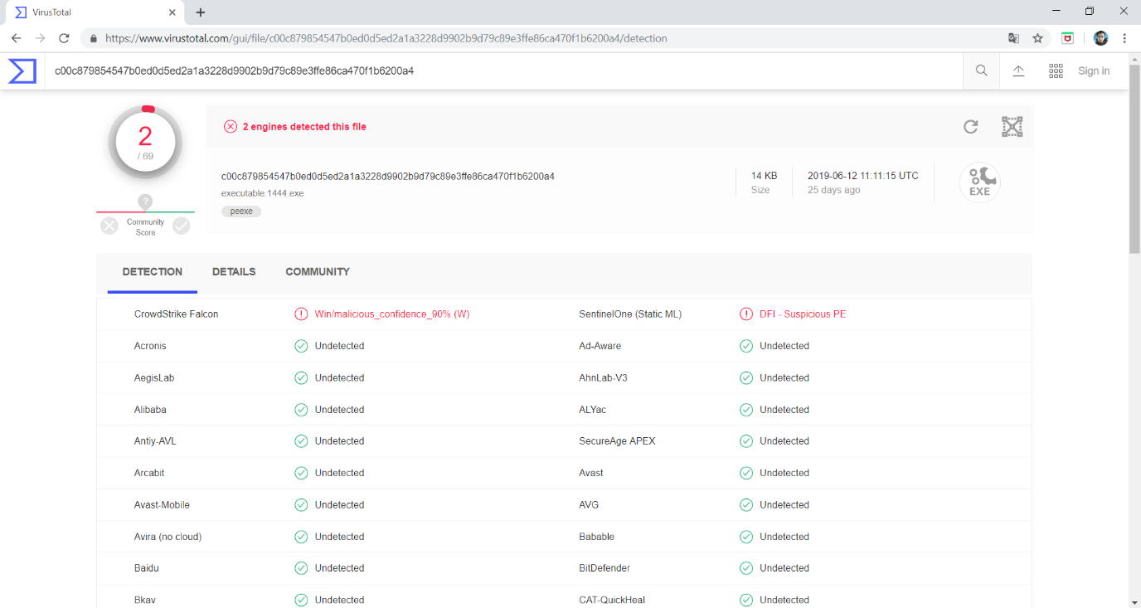
Analysis and Results: Memory Dumping
18

Slide 19
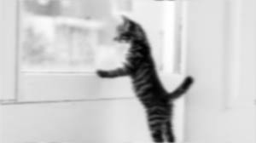
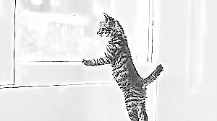
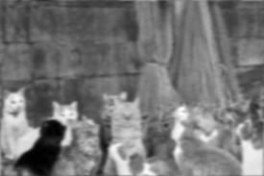
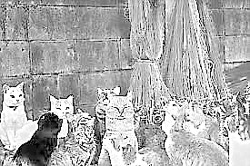

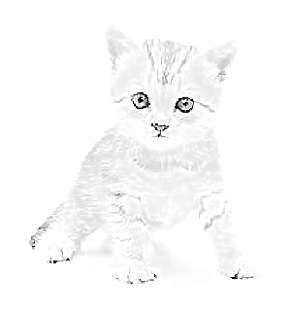






Analysis and Results: Digital Image Processing
Original
Enhanced
Original
Enhanced
19

Slide 20
Discussion
Binary classifier
(Better metrics than [7] [8] [9])
16-classes classifier
(Slightly better than [11])
4-classes classifier
(Slightly worse than [10] )
Refereces
[7] T. Carrier, P. Victor, A. Tekeoglu, and A. Lashkari, “Detecting Obfuscated Malware using Memory Feature Engineering,” Proceedings ofthe 8th International Conference on Information Systems Security and Privacy (ICISSP 2022), no. Icissp, pp. 177–188, 2022
[8] M. Dener, G. Ok, and A. Orman, “Malware Detection Using Memory Analysis Data in Big Data Environment,” Applied Sciences (Switzerland), vol. 12, no. 17, 2022
[9] L. Yang, G. Liu, Y. Dai, J. Wang, and J. Zhai, “Detecting stealthy domain generation algorithms using heterogeneous deep neural network framework,” IEEE Access, vol. 8, pp. 82 876–82 889, 2020.
[10] R. Vinayakumar, K. P. Soman, P. Poornachandran, S. Akarsh, and M. Elhoseny, Deep Learning Framework for Cyber Threat Situational Awareness Based on Email and URL Data Analysis. Cham: Springer International Publishing, 2019, pp. 87–124. [Online]. Available: https://doi.org/10.1007/978-3-030-16837-7 6
[11] R. Vinayakumar, K. P. Soman, P. P., S. Akarsh, and M. Elhoseny, Improved DGA Domain Names Detection and Categorization Using Deep Learning Architectures with Classical Machine Learning Algorithms. Cham: Springer International Publishing, 2019, pp. 161– 192. [Online]. Available: https://doi.org/10.1007/978-3-030-16837-7 8 Detection and Categorization Using Deep Learning Architectures with Classical Machine Learning Algorithms. Cham: Springer International Publishing, 2019, pp. 161– 192. [Online]. Available: https://doi.org/10.1007/978-3-030-16837-7 8
20

Slide 21
Conclusion
Conclusion:
Privacy malware identification and classification is a complex problem that depends in large extent on the quality of data to be solved.
CIC-MalMem-2022 dataset which employs a pattern and behavior’s volatile memory analysis is able to clearly distinguish between benign and malignant samples.
The dataset information must still be worked in order to achieve better models able to detect and classify malware at runtime in order to be incorporated in Yara rules as well as advanced malware protection solutions.
Cic-MalMem-2022 dataset is able to reach industrial thresholds and metrics for Yara rules building.
21

Slide 22
Gracias
david.cevallos03@epn.edu.ec

